Slide 1
Family of 4
THE SEAH FAMILY
>1500 BV / QUARTER
Notes:
Change from Month -> Quater

Slide 2
Are you a shop.com household?

Slide 3
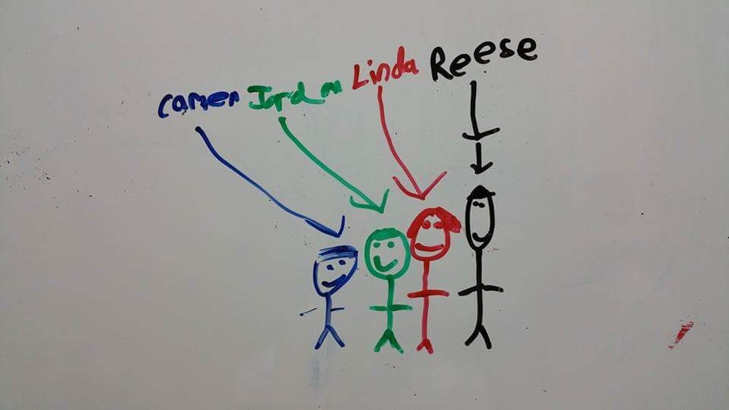
Adjust Your Shopping Behavior
IT STARTS WITH YOU!
Notes:
Replace the whole slide.

Slide 4
be a product of the product
Home shopping list
Notes:
Replace the whole slide.

Slide 5
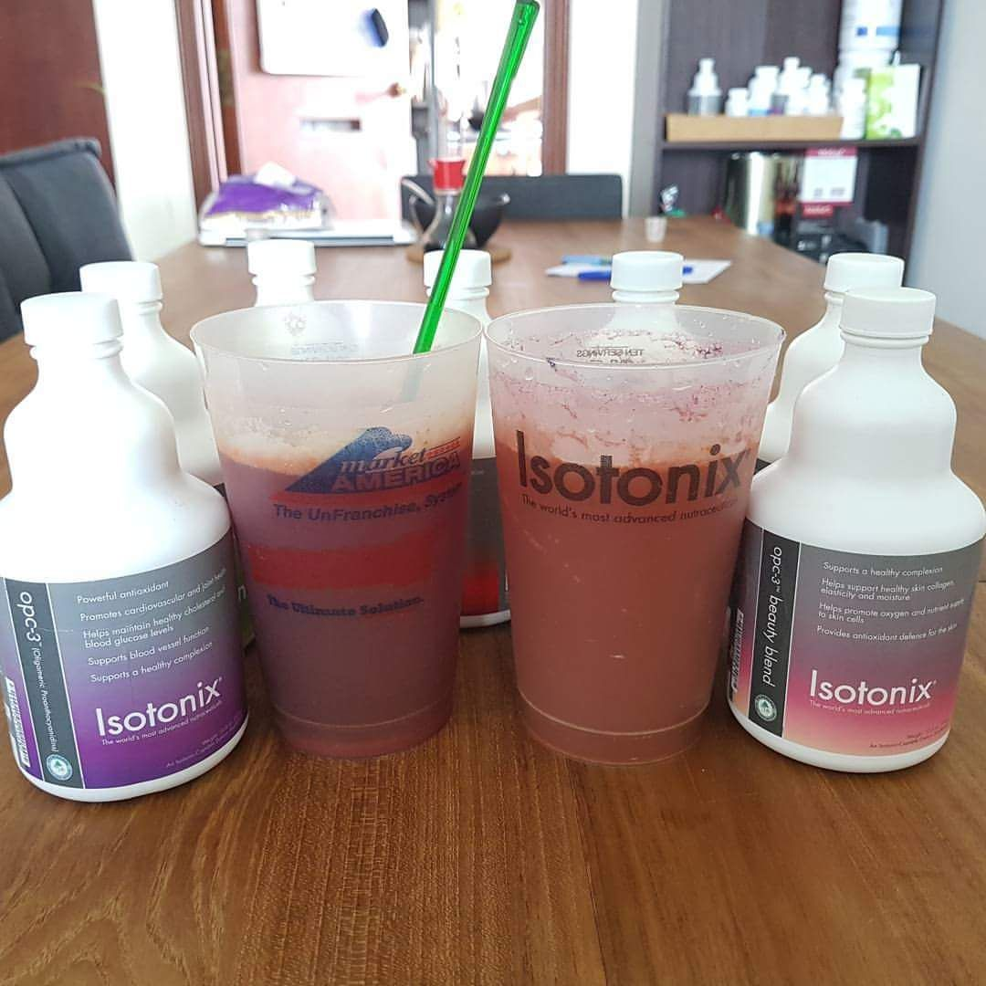
Notes:
Replace with this slide.

Slide 6
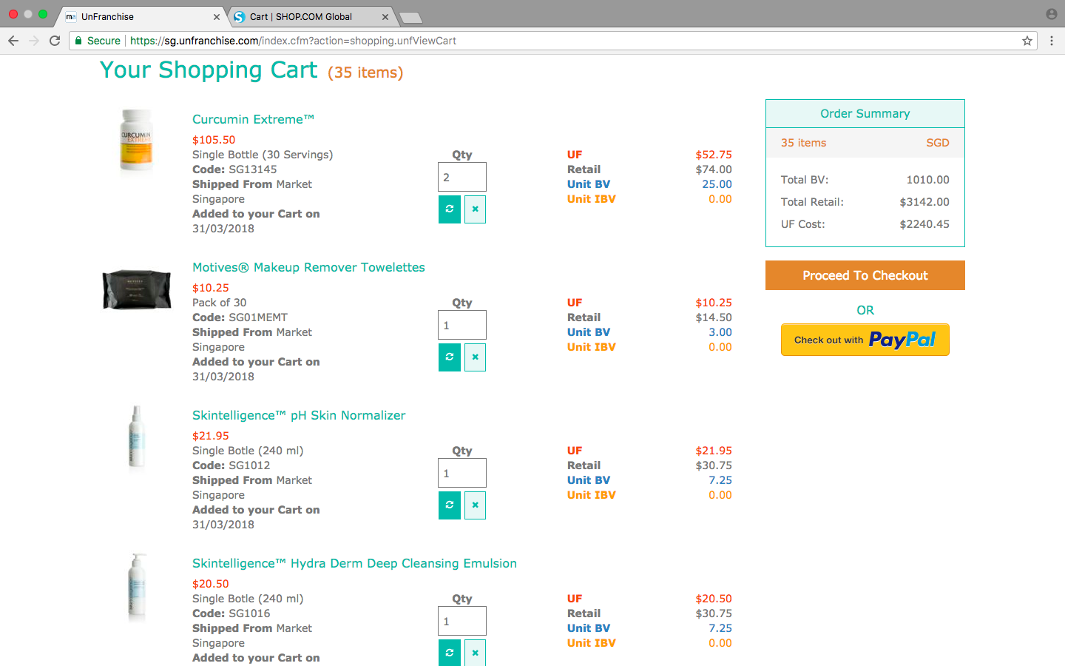
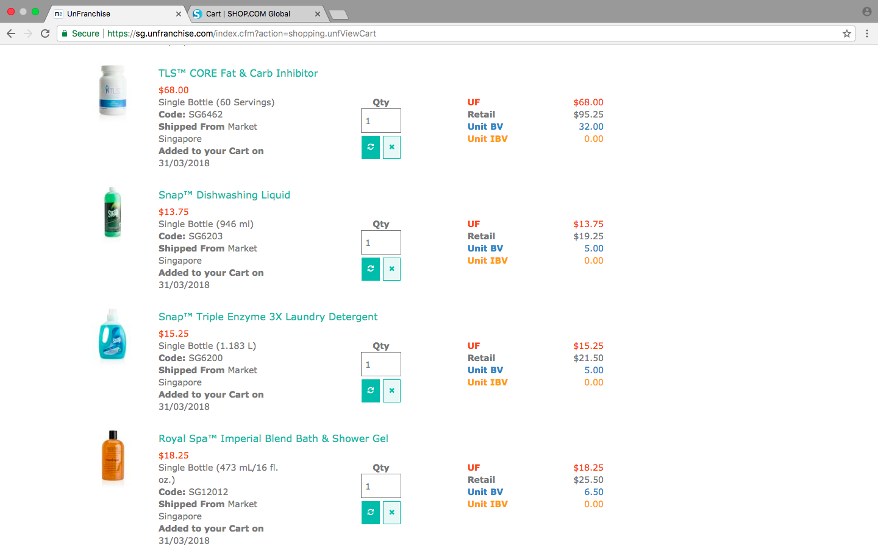
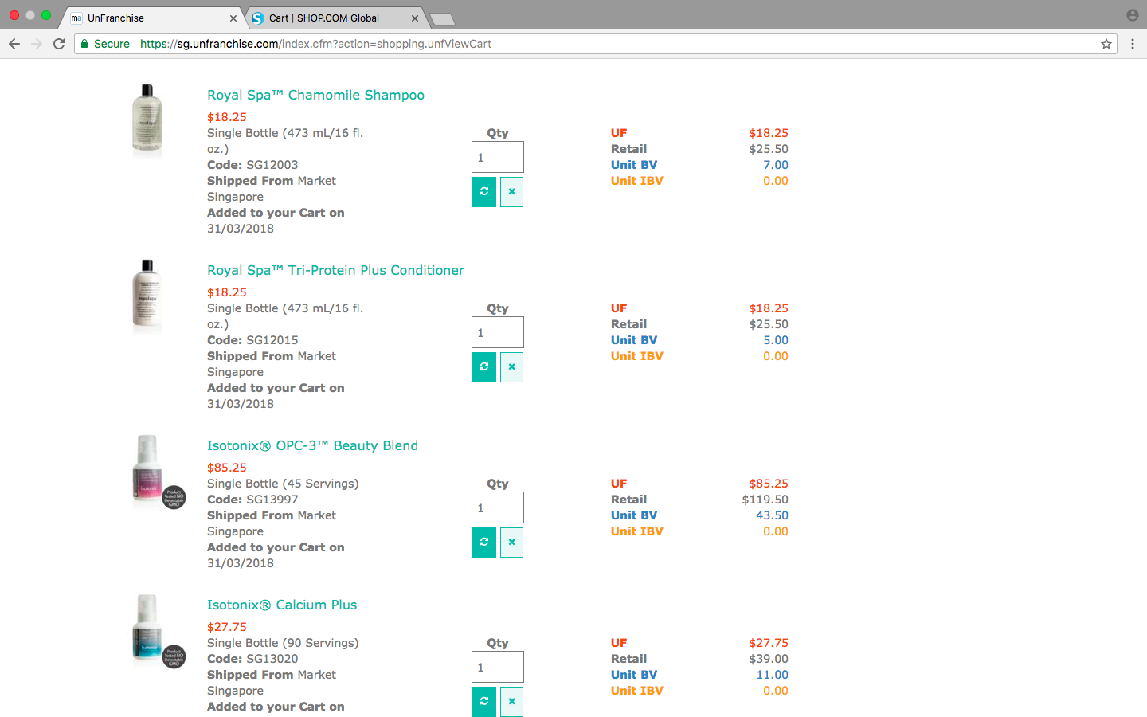
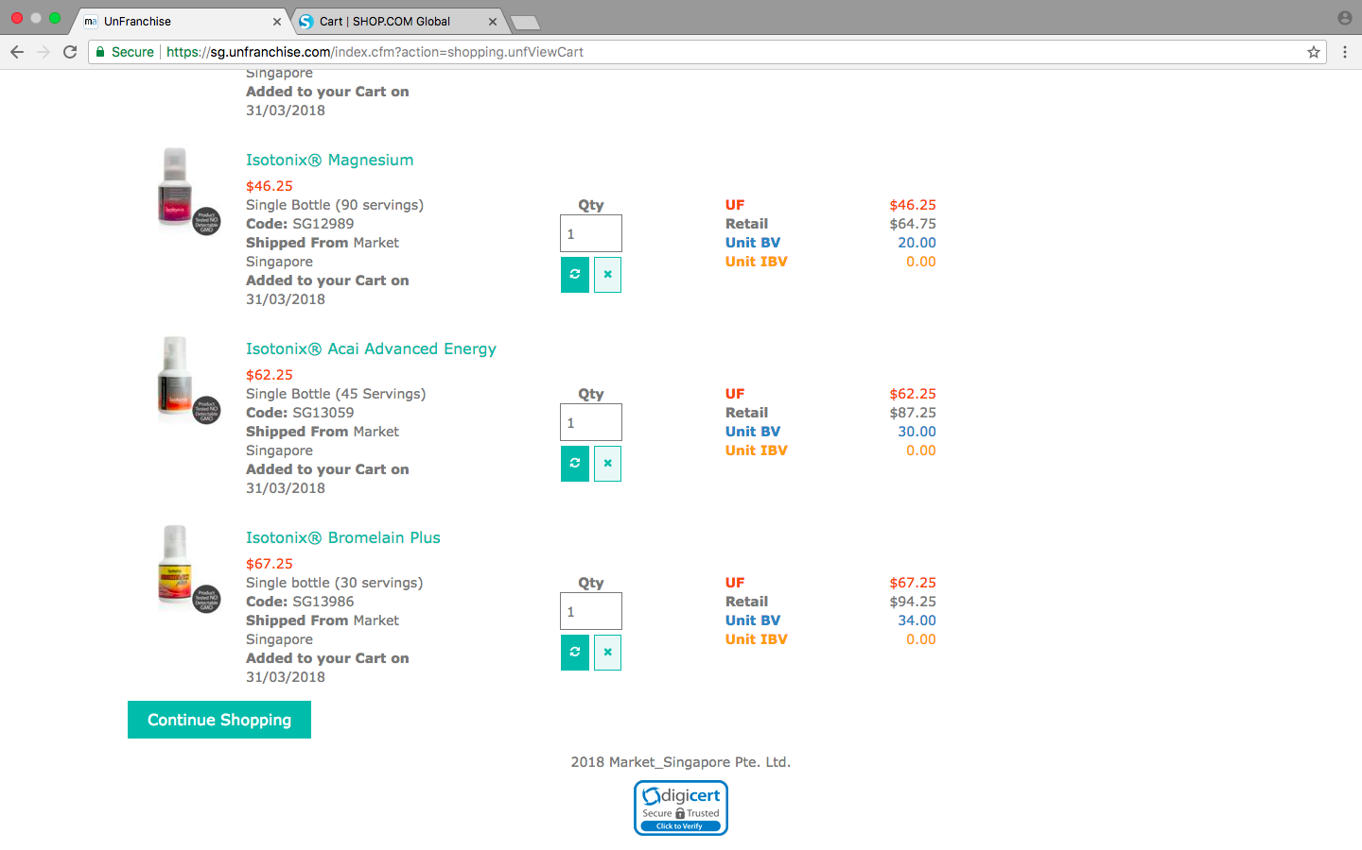
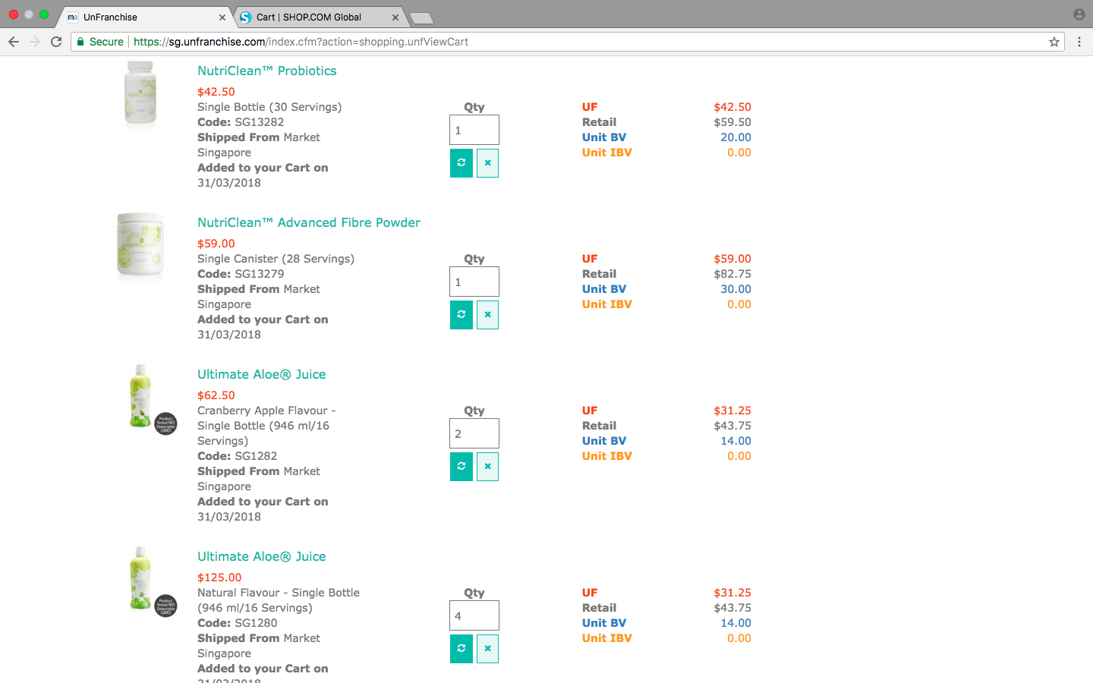
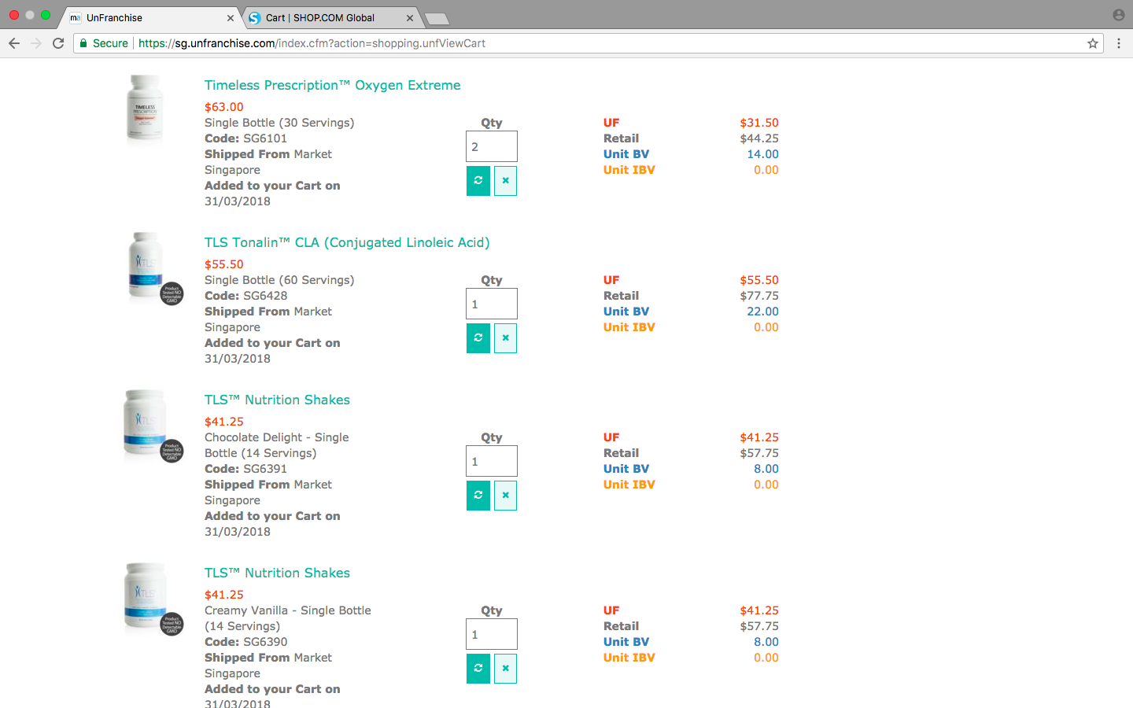
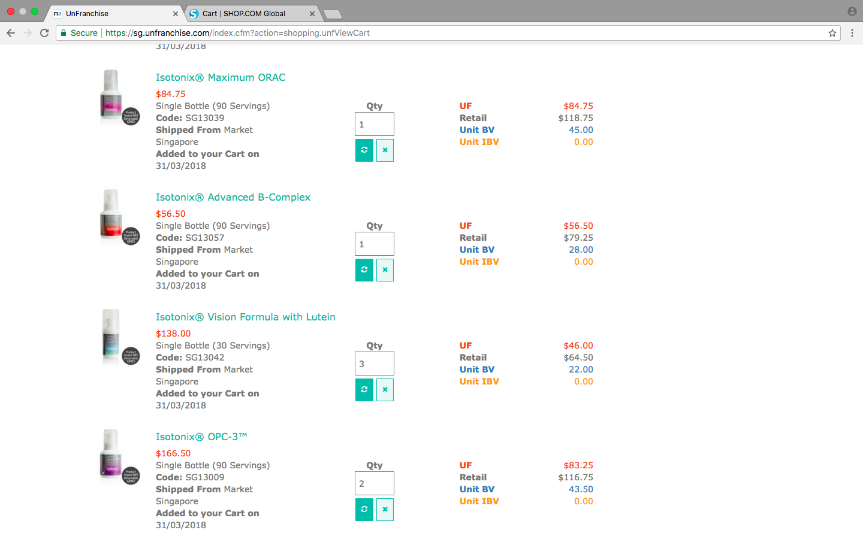
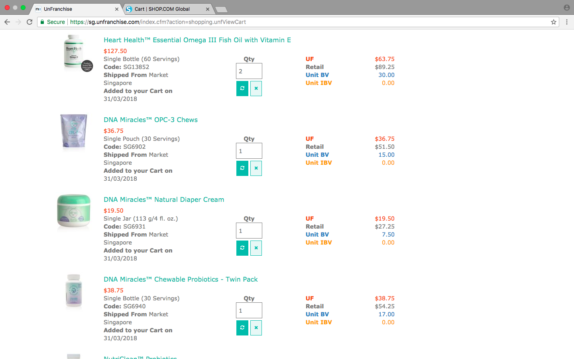

Slide 7
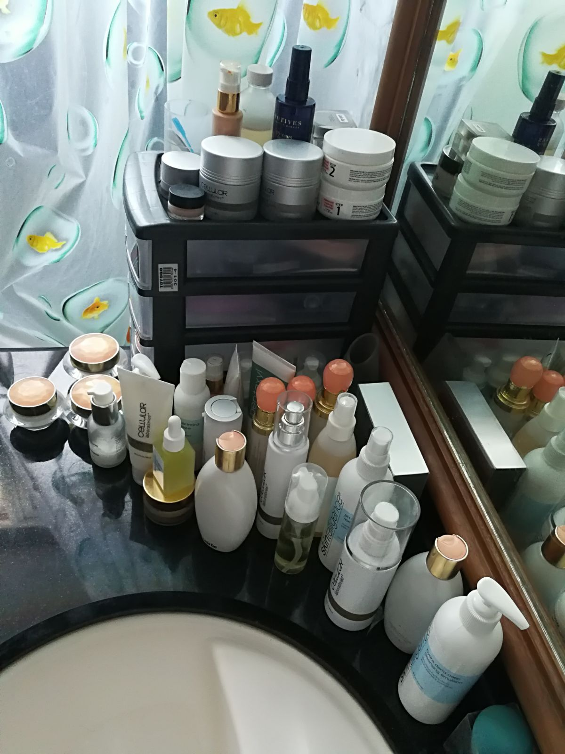
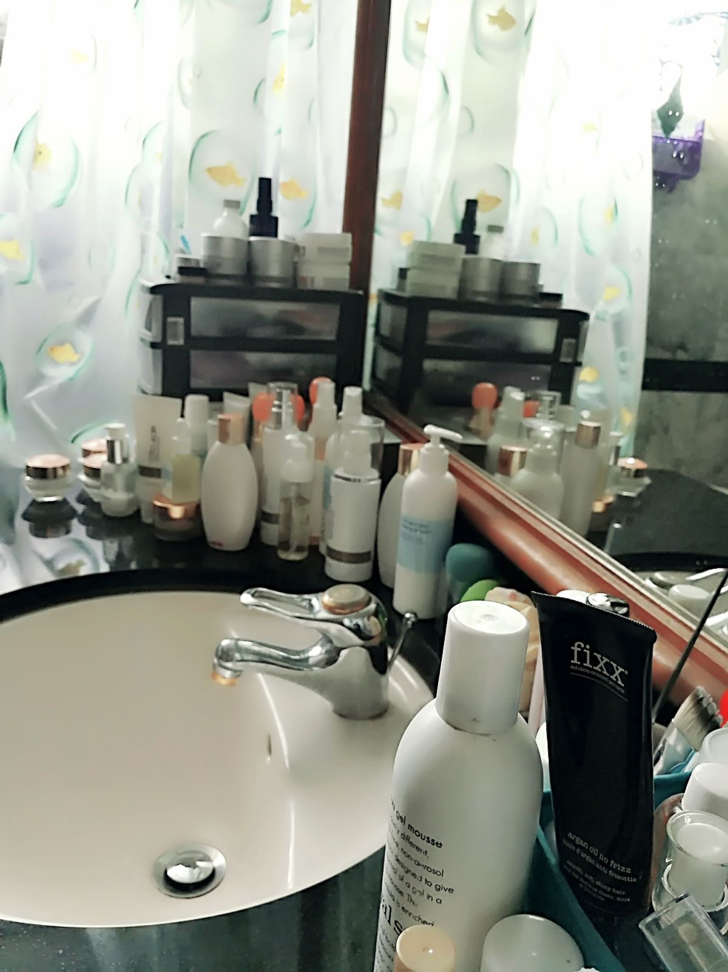
Notes:
Change with animation. Replace with this slide.

Slide 8
Invest in yourself and your business This is a business built on DUPLICATION

Slide 9
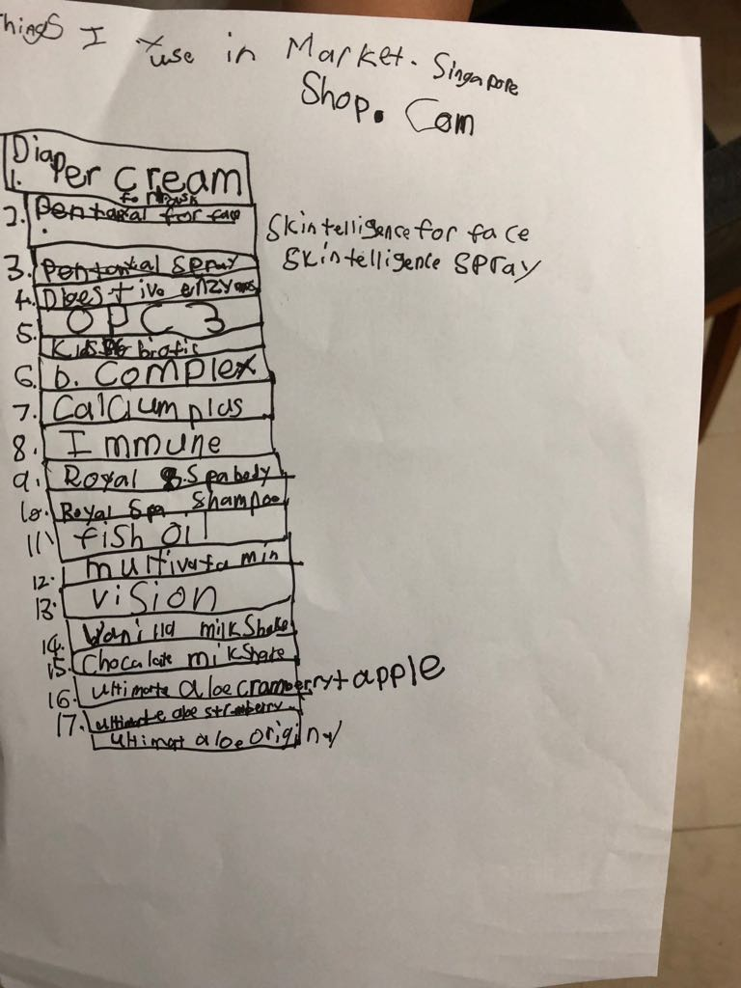

Slide 10
shop.com till you drop!!!

Slide 11
Thank you!

